Slide 1
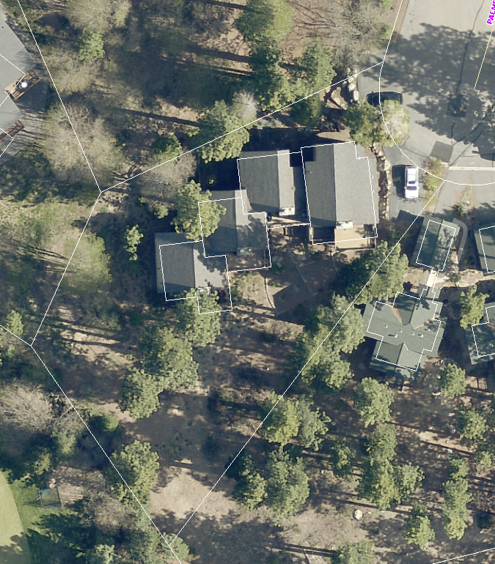
WPVAR19-0001 (Greenview HOA)
Washoe County Board of Adjustment
March 7, 2019

Slide 2
Background
Greenview is a 4 unit condominium located on a cul-de-sac that was built in 1979 without garages
The property is zoned LDU (Low Density Urban), which requires 15 foot front and rear setbacks and 5 foot side yard setback
The variance is requesting a reduction to the front yard setback from 15 feet to 1 ½ feet and the side yard setback on the northwest side from 5 feet to 1 foot
The request is to construct 2 car garages in the HOA common area- 1-car garage and 2-car garage

Slide 3
Background
In August 2017 the applicant requested a variance to reduce the front yard setback from 15 feet to 1 foot and reduce both side yard setbacks from 5 feet to 1 foot to construct 2 double car garages
BOA denied the application saying the Board could not make findings 2 & 3 - that the variance would be a detriment and it would be a special privilege
The applicant has revised the setback request and is now proposing 1-car garage and 2-car garage

Slide 4
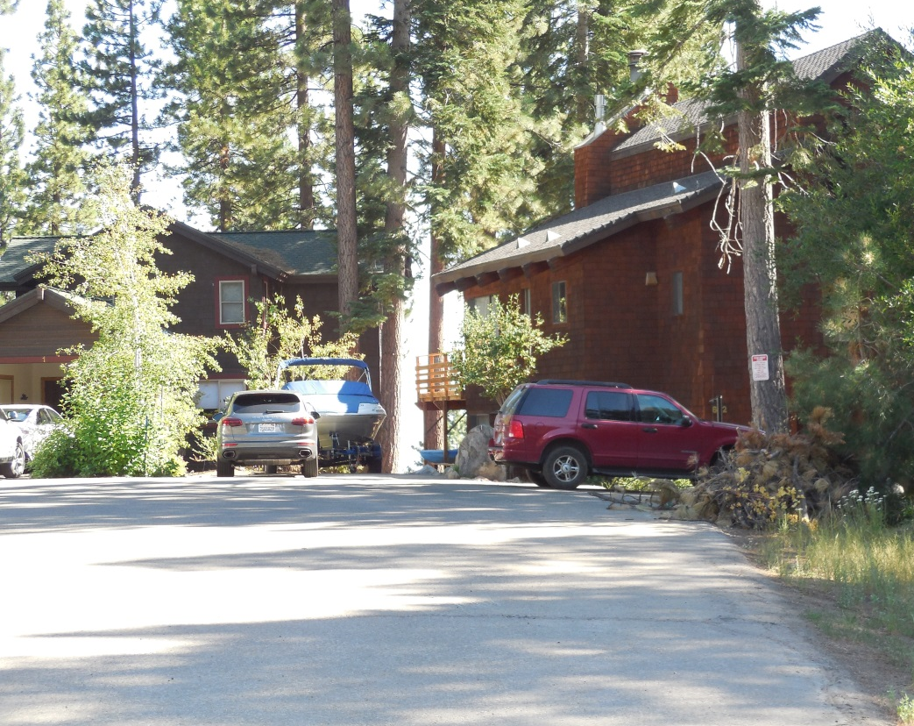
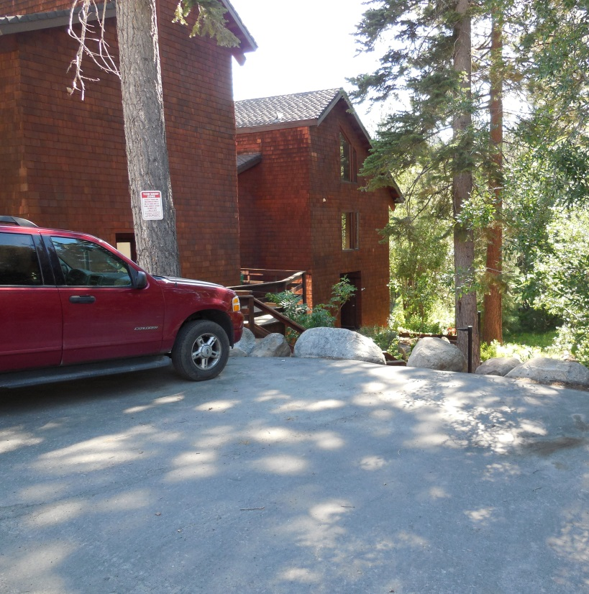
Garage Locations (photos dated August 2017)

Slide 5
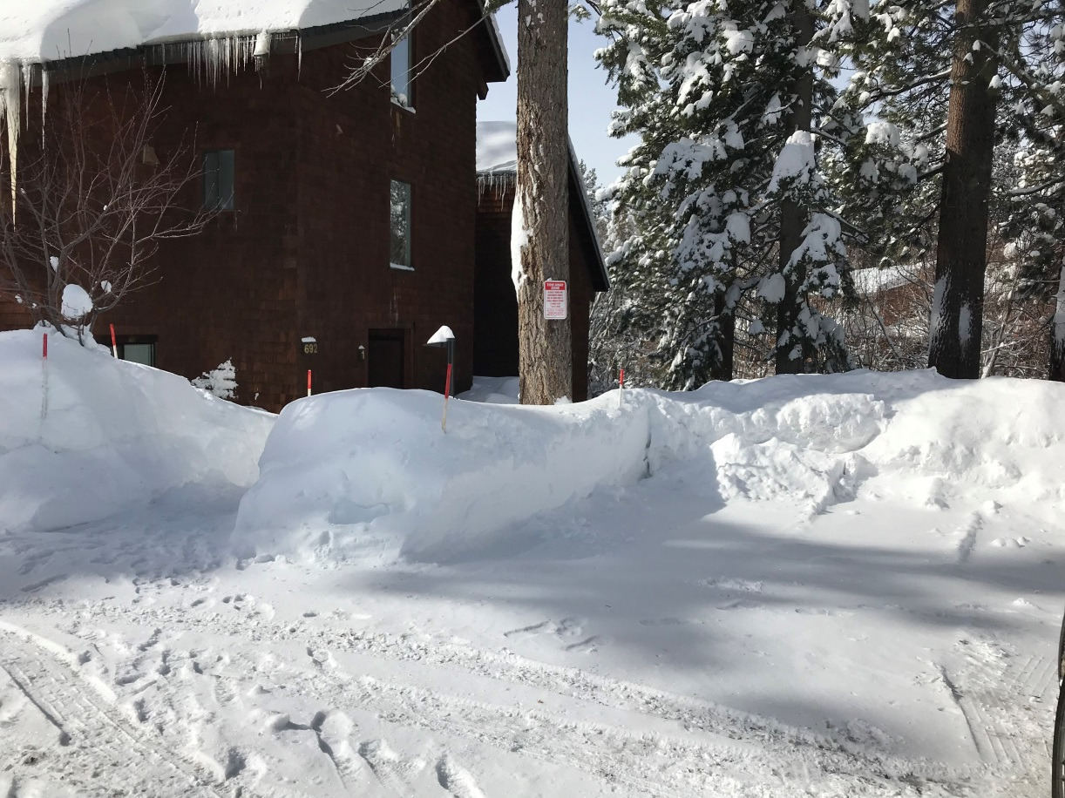
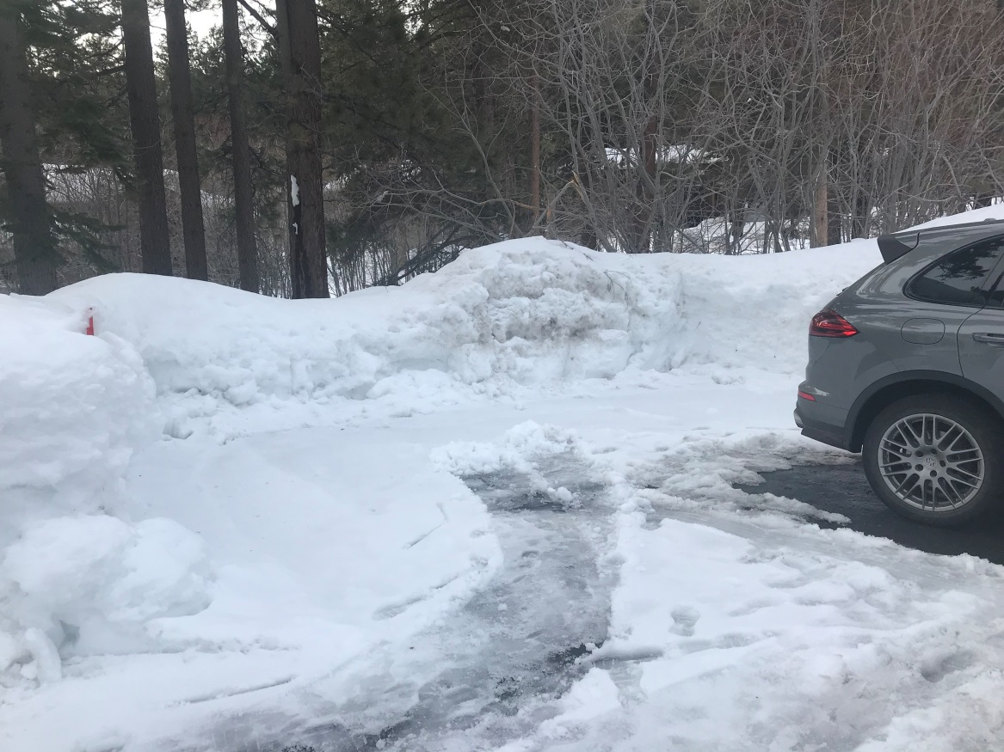
Location of 2-car garage
Nevada State Lands
.57 acre parcel
Walk way to Units

Slide 6
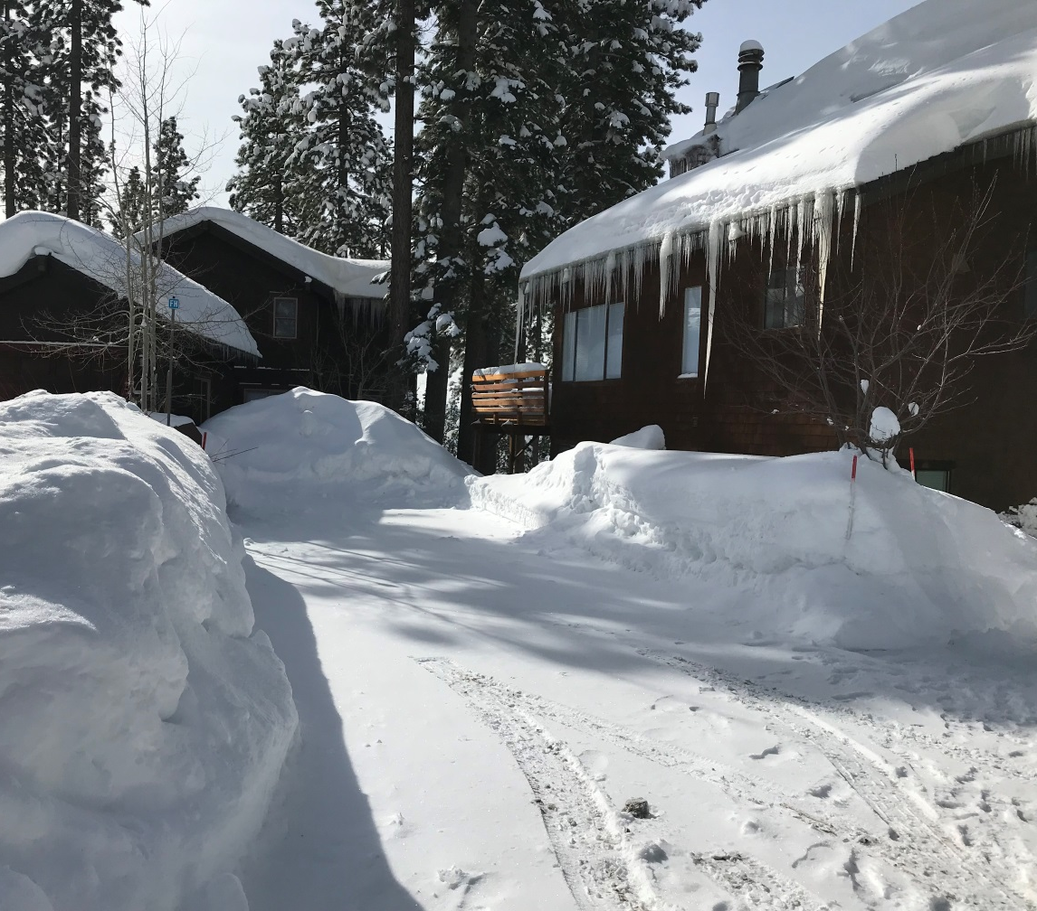
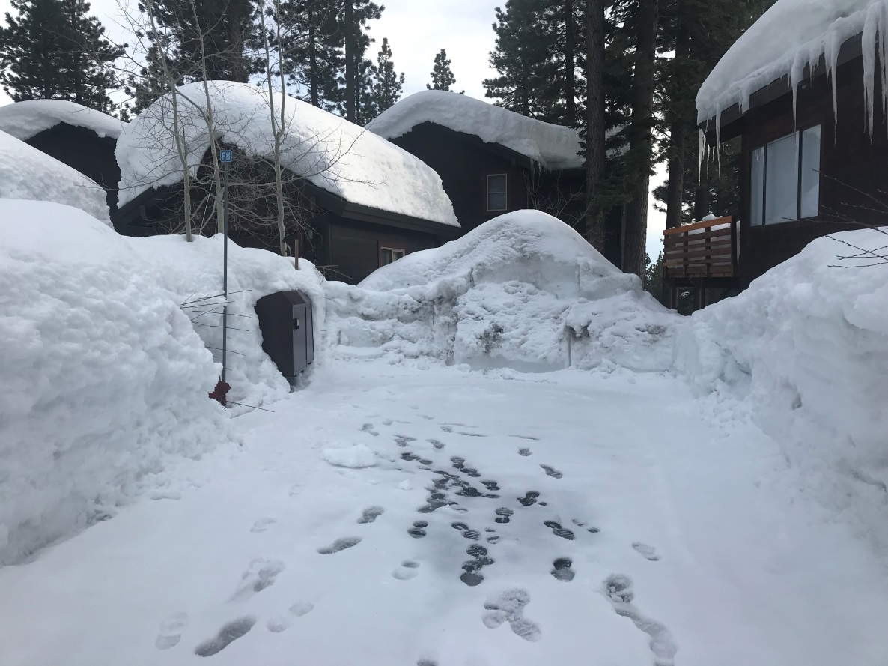
Location of 1-car garage

Slide 7
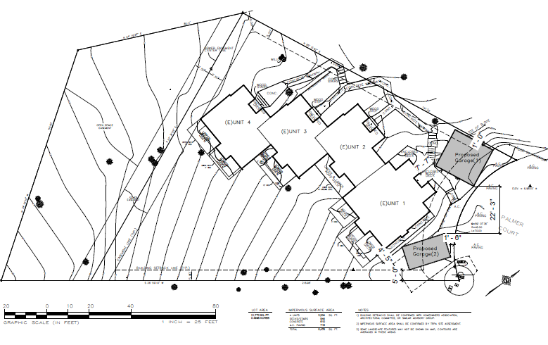
Site Plan

Slide 8
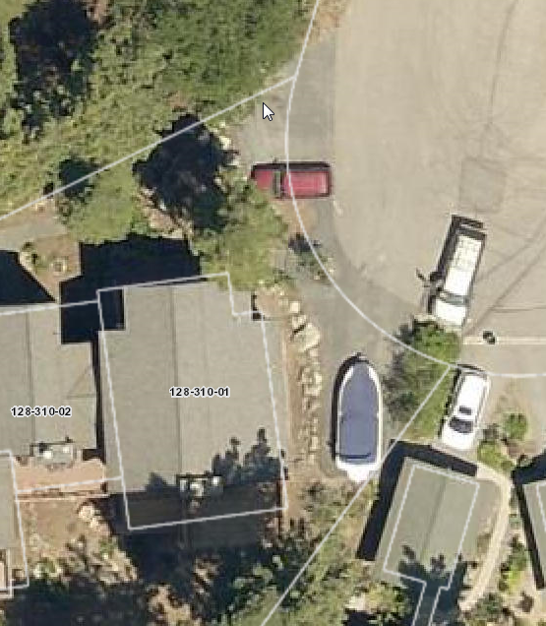

Slide 9
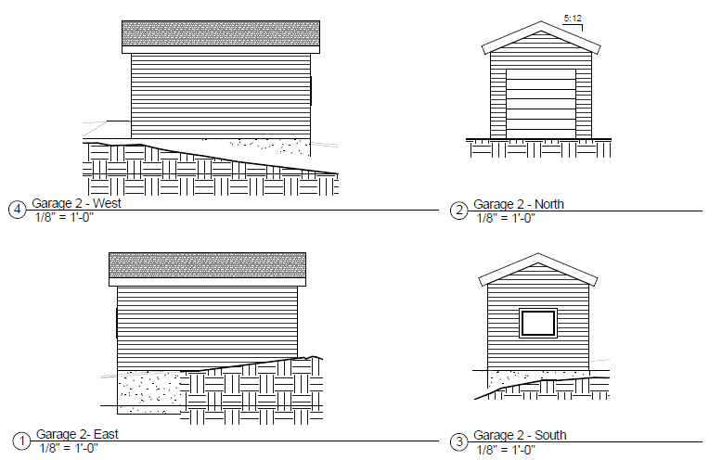
Proposed 1-Car Garage Elevations

Slide 10
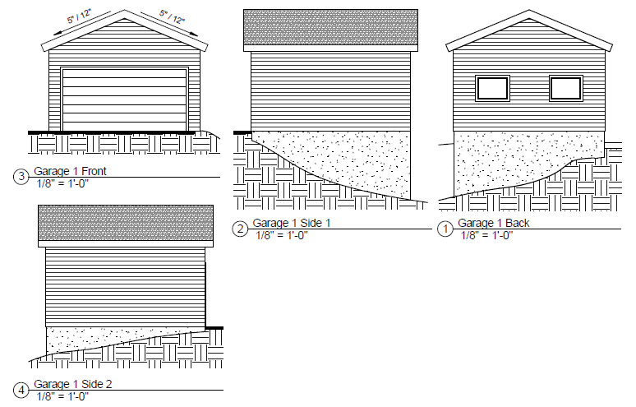
Proposed 2-car Garages Elevations elevations

Slide 11
Analysis
The parcel is sloped and wedge shaped with the narrowest part of the parcel is located along the cul-de-sac
There is an open space and a sewer easement that crosses the rear of the property just below the condominium units
Currently the condominiums have no garages
Parking for the condominium is only on paved parking pads or the street
Neighboring properties on the cul-de-sac have garages

Slide 12
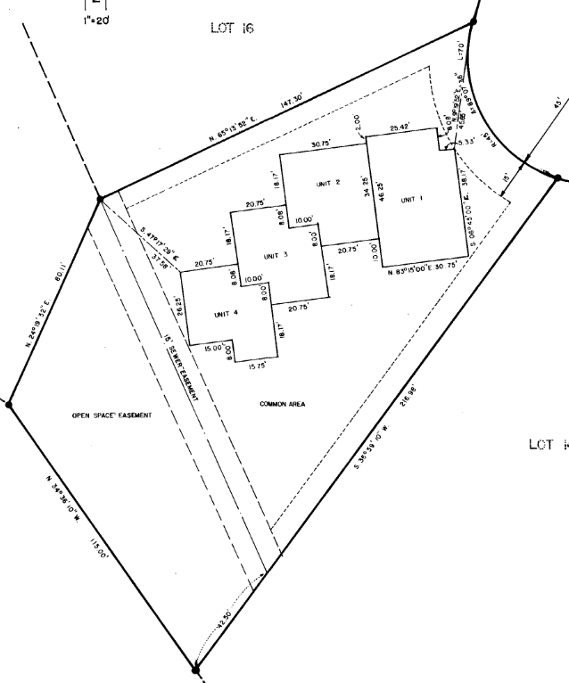
Sewer Easement
Open Space Easement

Slide 13
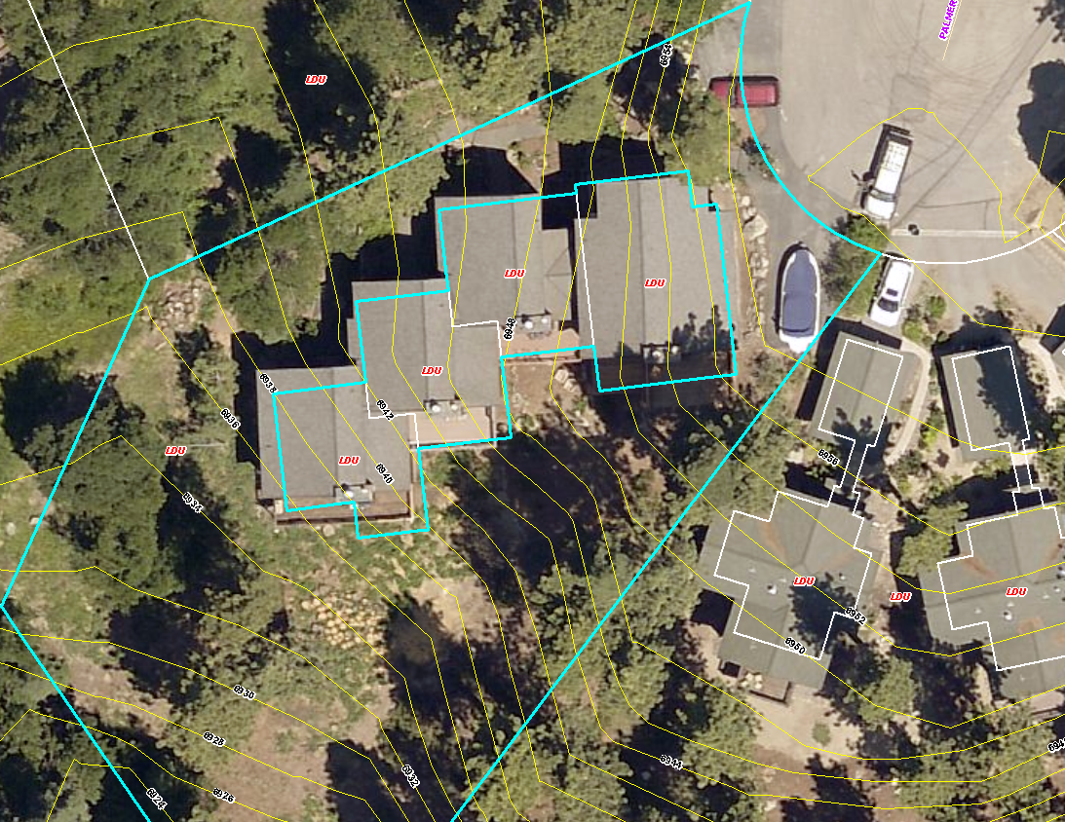
2-foot Contours
6958 ft.
6924 ft.

Slide 14
Analysis
Current code requires 2 parking spaces per dwelling unit and 1 space must be in an enclosed garage
This application would bring the parcel into closer compliance with current code
Also would better meet the winter parking requirements

Slide 15
Reviewing Agencies
Washoe County Community Services Department
    Planning and Building Division
      Planning Program
      Building Program
    Engineering and Capital Projects Division
      Land Development
    Operations Division
      Incline Village Roads Department
Washoe County Health District
      Air Quality Management Division
      Environmental Health Services Division
Incline Village General Improvement District
North Lake Tahoe Fire Protection District
Nevada Tahoe Conservation District
Regional Transportation Commission
Nevada State Lands

Slide 16
Reviewing Agencies
6 out of the 11 reviewing agencies provided comments or conditions and are detailed in the staff report in Exhibit C

Slide 17
Citizen Advisory Board/Public Comment
The Incline Village/Crystal Bay Citizen Advisory Board meeting on February 4th was canceled because of weather
All CAB members received worksheets to provide comments concerning the proposed project and 2 CAB members emailed CAB worksheets that were included in the staff report in Exhibit F
There are numerous emails from the neighboring properties that were included in the staff report in Exhibit E

Slide 18
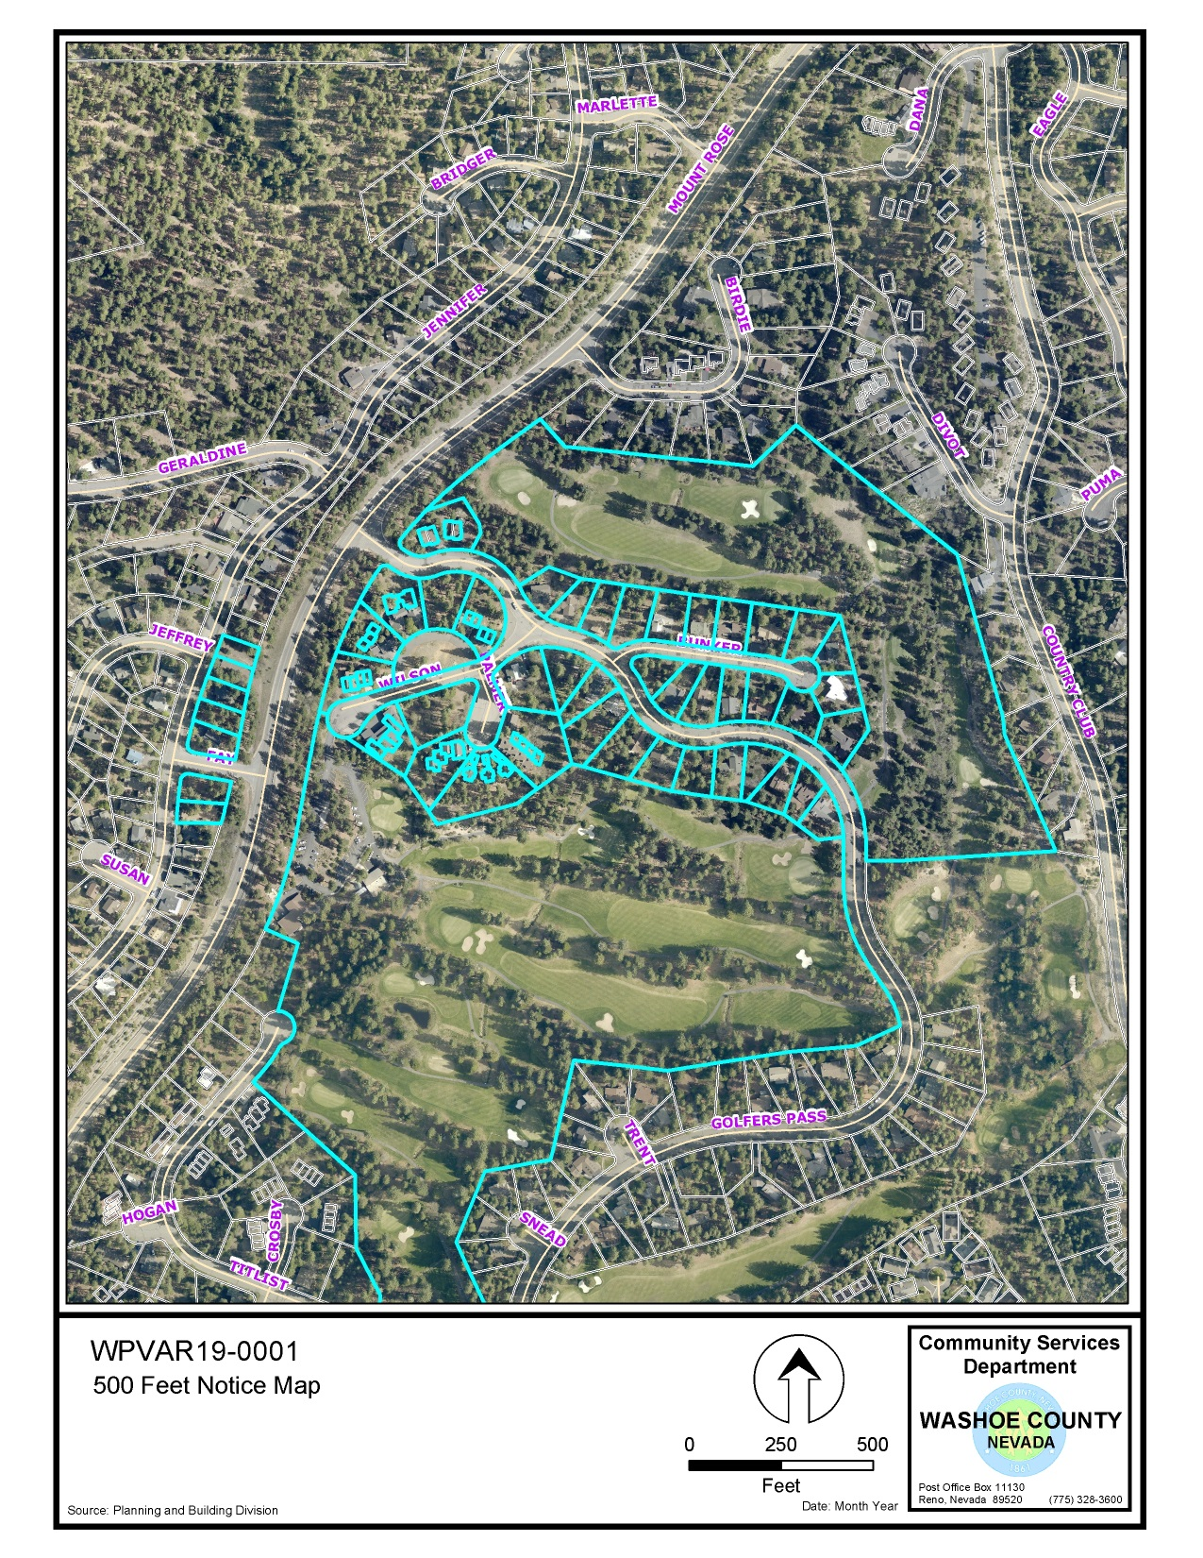
A total of 64 properties within 500 feet were noticed
Project Site

Slide 19
Required Findings
Staff is able to make Variance Findings- WCC Section 110.804.25:
  Special Circumstances (Exceptional narrowness, exceptional topography, exceptional situation)
  The lot is narrow at the street, is sloped and has topography issues, there are existing easements, and no access to the rear of the property
  No detriment
  Construction of garages on the property will bring the property into closer conformance with current parking codes and provide off street parking, which helps with winter parking requirements

Slide 20
Required Findings
3. Not a granting of special privileges
  Neighboring properties have garages and variances have been granted to other properties in the Incline Village area to vary setbacks to allow for the construction of garages
  4. Use authorized
  Current code requires 2 parking spaces per dwelling unit and 1 parking space must be in an enclosed garage

Slide 21
Possible Motion
I move that, after considering the information contained within the staff report and the information received during the public hearing, the Washoe County Board of Adjustment approve, with the conditions included at Exhibit A to the staff report for this item, Variance Case Number WPVAR19-0001 for Greenview HOA, being able to make the findings required by Washoe County Code Section 110.804.25 for approval of Variances.

